Slide 1
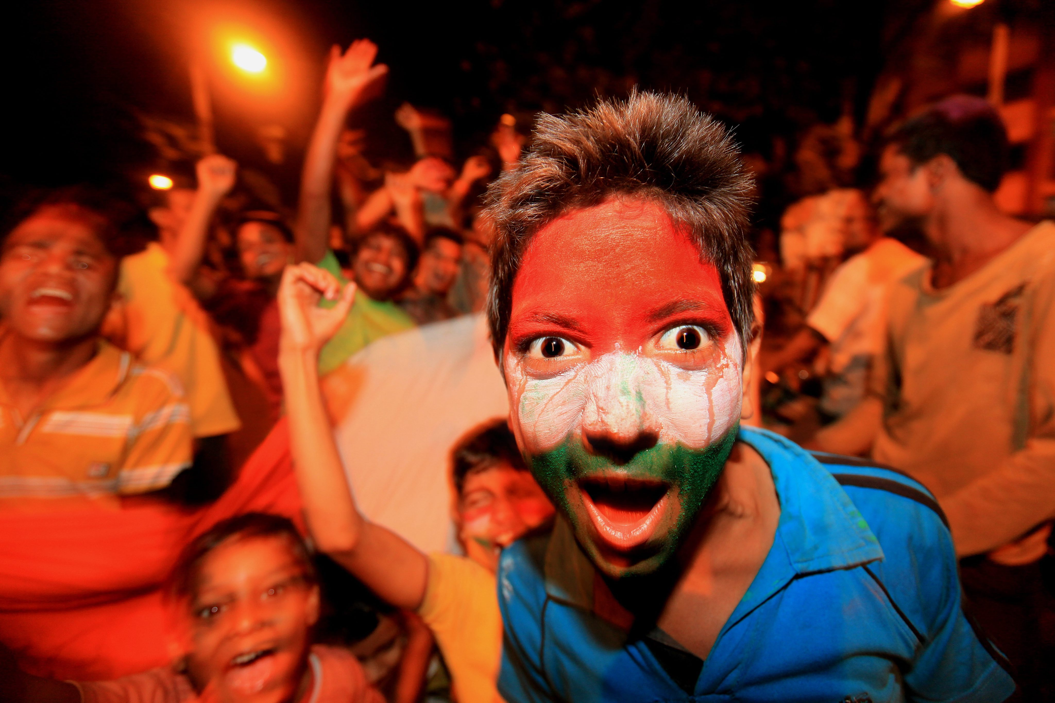
When a fan becomes a follower...
Part 1
Dealing with money
11 AM, Sunday, August 30 @ 20 Downtown, Second floor, Eros Theatre Building. (Entrance next to CCD) Opp. Churchgate station

Slide 2
Jesus drew three responses from people

Slide 3
Three responses to jesus
Many people hated Jesus Christ
Many became His fans
A few became His followers

Slide 4
Differences between fans and followers
Dealing with money
Romance and sex
Careers
Church & Community
Evangelism

Slide 5
If Jesus had stayed outside the field of life and cheered us, we could have remained a fan and cheered him.
But Jesus entered the field of life as our substitute. God became man. God died for man. Christ died for us.
We cannot just cheer a God like this. His love inspires us to give up our lives for Him, just as he gave up His life for us.

Slide 6
“Whoever wants to be my disciple must deny themselves and take up their cross daily and follow me.
Luke 9:23

Slide 7
Dealing with money!
When a fan becomes a follower

Slide 8
1 Timothy 6
6 But godliness with contentment is great gain. 7 For we brought nothing into the world, and we can take nothing out of it. 8 But if we have food and clothing, we will be content with that. 9 Those who want to get rich fall into temptation and a trap and into many foolish and harmful desires that plunge people into ruin and destruction. 10 For the love of money is a root of all kinds of evil. Some people, eager for money, have wandered from the faith and pierced themselves with many griefs.

Slide 9
1 Timothy 6
11 But you, man of God, flee from all this, and pursue righteousness, godliness, faith, love, endurance and gentleness. 12 Fight the good fight of the faith. Take hold of the eternal life to which you were called when you made your good confession in the presence of many witnesses.

Slide 10
1 Timothy 6
17 Command those who are rich in this present world not to be arrogant nor to put their hope in wealth, which is so uncertain, but to put their hope in God, who richly provides us with everything for our enjoyment. 18 Command them to do good, to be rich in good deeds, and to be generous and willing to share. 19 In this way they will lay up treasure for themselves as a firm foundation for the coming age, so that they may take hold of the life that is truly life.

Slide 11
One Massive problem with this passage!

Slide 12
1 Timothy 6
For the love of money is a root of all kinds of evil.
Some people, eager for money, have wandered from the faith and pierced themselves with many griefs.
IS MONEY BAD?
HOW CAN YOU NOT LOVE MONEY?

Slide 13
Philarguria
Avarice....extreme greed for wealth or material gain.

Slide 14
Money is not evil!
An avarice for MONEY that is stronger THAn my love for God is evil.

Slide 15
1) The love of money is a big fight for both fans and followers of Christ
2) A fan hopes more in money than Christ; a follower hopes more in Christ than in money
3) A fan loves Christ for money; a follower loves Christ with his money

Slide 16
1) The love of money is a big fight for both fans and followers of Christ

Slide 17
1 Timothy 6
Some people, eager (philarguria) for money, have wandered from the faith and pierced themselves with many griefs. 11 But you, man of God, flee from all this, and pursue righteousness, godliness, faith, love, endurance and gentleness. 12 Fight the good fight of the faith.

Slide 18
Peculiar allure of money!
In itself money is worth nothing.
But money has the power to buy anything we want.

Slide 19
Often, we see money as the portal through which we can have all that our hearts desire

Slide 20
Very often, money is the one idol that comes to represent most other idolatries of our hearts

Slide 21
Money is the currency of our idolatries

Slide 22
To over come our philarguria of money, we must uncover and understand the specific heart idolatry money has come to represent

Slide 23
2) A fan hopes more in money than Christ; a follower hopes more in Christ than in money

Slide 24
1 Timothy 6
17 Command those who are rich in this present world not to be arrogant nor to put their hope in wealth, which is so uncertain, but to put their hope in God, who richly provides us with everything for our enjoyment.

Slide 25
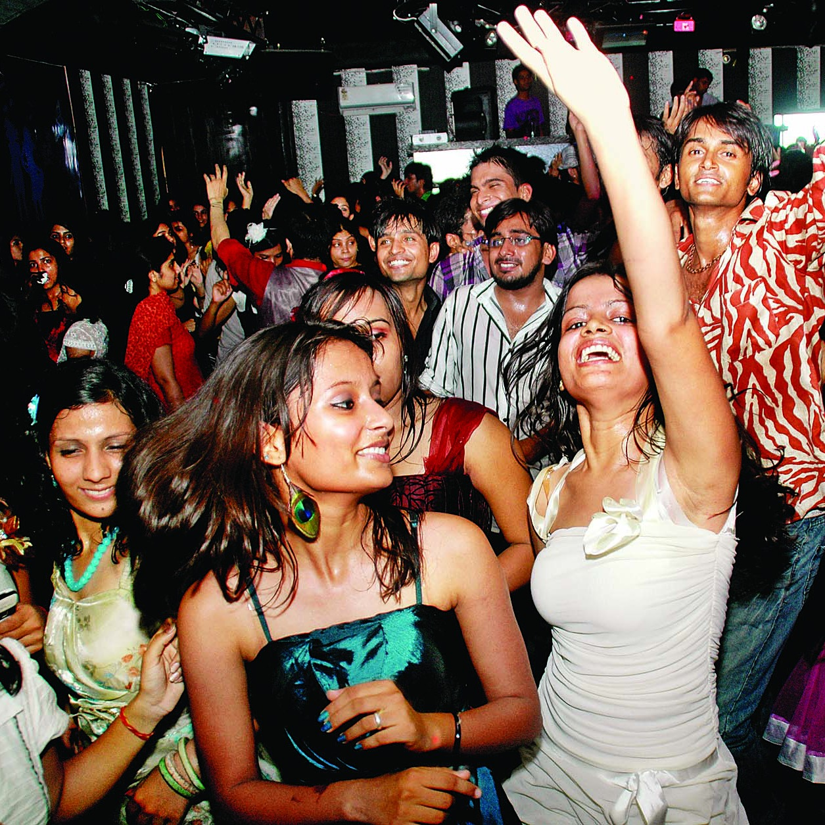
Enjoyment

Slide 26
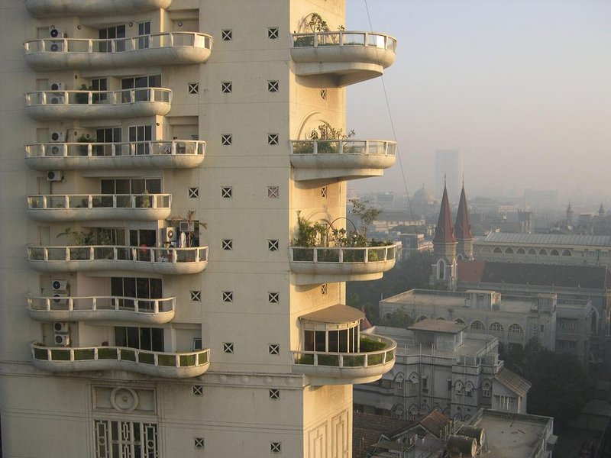
Comfort

Slide 27
Security

Slide 28
Twenties - enjoyment
Thirties - comfort
Forties - security

Slide 29
3) A fan loves Christ for money; a follower loves Christ WITH his money

Slide 30
1 Timothy 6:4-5
FAN
“They are conceited and understand nothing.
They....think that godliness is a means to financial gain.”

Slide 31
1 Timothy 6
FOLLOWER
18 Command them (those who are rich) to do good, to be rich in good deeds, and to be generous and willing to share..

Slide 32
How can I love Christ with my money?

Slide 33
Loving Christ with my money
To do good
To be rich in good deeds
Generous and willing to share

Slide 34
Our sins are so wicked that God Himself had to die to atone for our sins
No other sacrifice was good enough to atone for our sins

Slide 35
“For you know the grace of our Lord Jesus Christ, that though he was rich, yet for your sake he became poor, so that you through his poverty might become rich.”
2 Corinthians 8:9

Slide 36
1) our tithing is a feeble response to so great a love
2) our tithing is a monthly testing of our own hearts. Do I really love christ?

Slide 37
Two encounters with Jesus

Slide 38
Mark 10:17-22
“As Jesus started on his way, a man ran up to him and fell on his knees before him. “Good teacher,” he asked, “what must I do to inherit eternal life?” “Why do you call me good?” Jesus answered. “No one is good—except God alone. You know the commandments: ‘You shall not murder, you shall not commit adultery, you shall not steal, you shall not give false testimony, you shall not defraud, honor your father and mother.’ ” “Teacher,” he declared, “all these I have kept since I was a boy.” Jesus looked at him and loved him. “One thing you lack,” he said. “Go, sell everything you have and give to the poor, and you will have treasure in heaven. Then come, follow me.” At this the man’s face fell. He went away sad, because he had great wealth.”

Slide 39
Luke 19:1-10
1 Jesus entered Jericho and was passing through. 2 A man was there by the name of Zacchaeus; he was a chief tax collector and was wealthy. 3 He wanted to see who Jesus was, but because he was short he could not see over the crowd. 4 So he ran ahead and climbed a sycamore-fig tree to see him, since Jesus was coming that way.
5 When Jesus reached the spot, he looked up and said to him, “Zacchaeus, come down immediately. I must stay at your house today.” 6 So he came down at once and welcomed him gladly.
7 All the people saw this and began to mutter, “He has gone to be the guest of a sinner.”
8 But Zacchaeus stood up and said to the Lord, “Look, Lord! Here and now I give half of my possessions to the poor, and if I have cheated anybody out of anything, I will pay back four times the amount.”
9 Jesus said to him, “Today salvation has come to this house, because this man, too, is a son of Abraham. 10 For the Son of Man came to seek and to save the lost.”

