Slide 1
#3 Fan To Follower Series
Christ
And Our
Careers
11 AM, Sunday, Oct 4 @ 20 Downtown,
Second floor, Eros Theatre Building.
(Entrance next to CCD) Opp. Churchgate station

Slide 2
“I will remain in the world no longer, but they are still in the world, and I am coming to you.
Holy Father, protect them by the power of your name, the name you gave me, so that they may be one as we are one. While I was with them, I protected them and kept them safe by that name you gave me. None has been lost except the one doomed to destruction so that Scripture would be fulfilled.
“I am coming to you now, but I say these things while I am still in the world, so that they may have the full measure of my joy within them.”
John 17:11-19 NIV

Slide 3
“I have given them your word and the world has hated them, for they are not of the world any more than I am of the world.
My prayer is not that you take them out of the world but that you protect them from the evil one.
They are not of the world, even as I am not of it.
Sanctify them by the truth; your word is truth.
As you sent me into the world, I have sent them into the world.
For them I sanctify myself, that they too may be truly sanctified.”
John 17:14-19 NIV

Slide 4
The CALL to be in the world
The CHALLENGES of being in the world
The CONFIDENCE to be in the world

Slide 5
The CALL to be in our careers
The CHALLENGES of being in our careers
The CONFIDENCE to be in our careers

Slide 6
The CALL to be in our careers

Slide 7
JESUS' PRAYER
I will remain in the world no longer, but they are still in the world.....
My prayer is not that you take them out of the world
As you sent me into the world, I have sent them into the world.

Slide 8
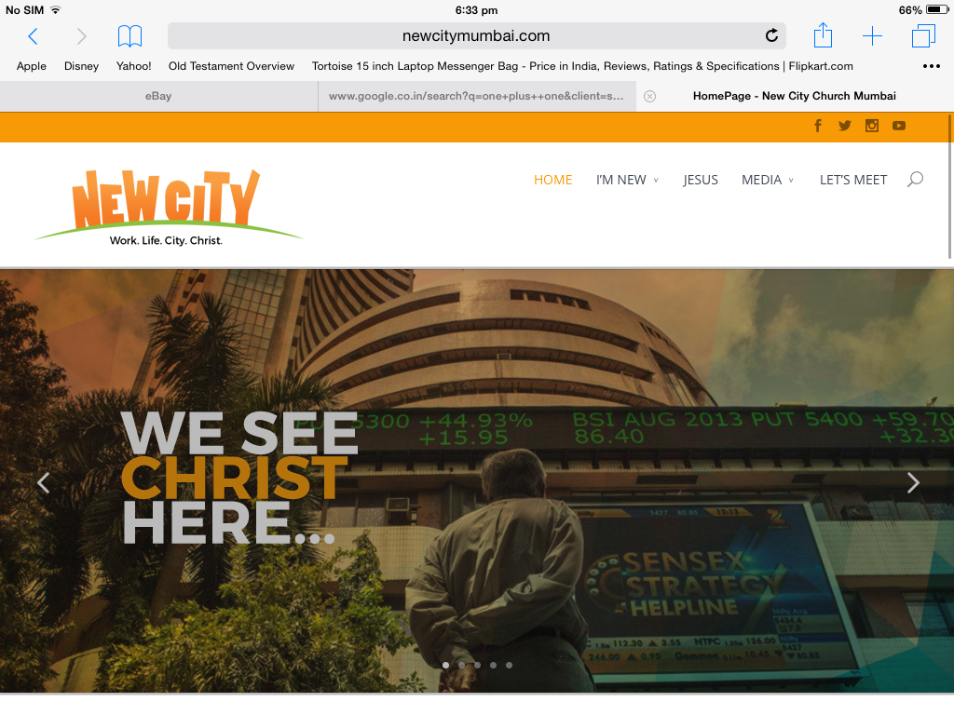

Slide 9
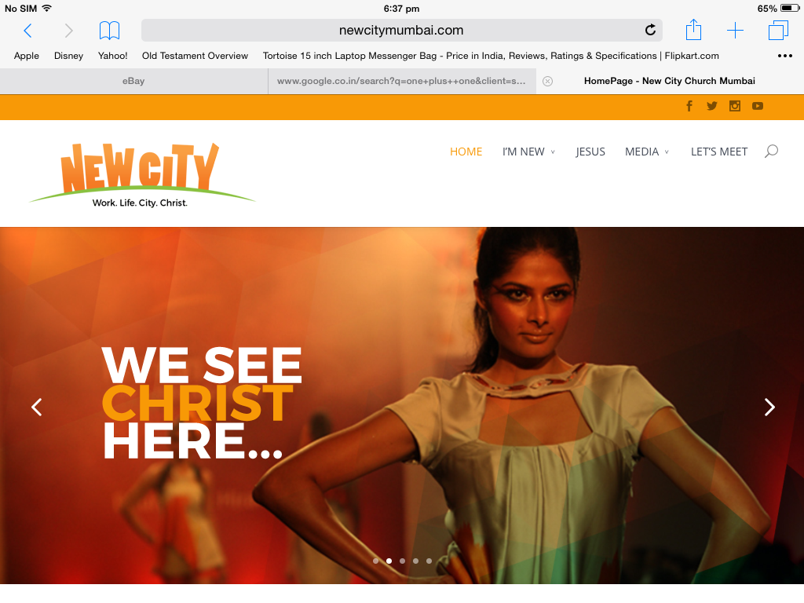

Slide 10
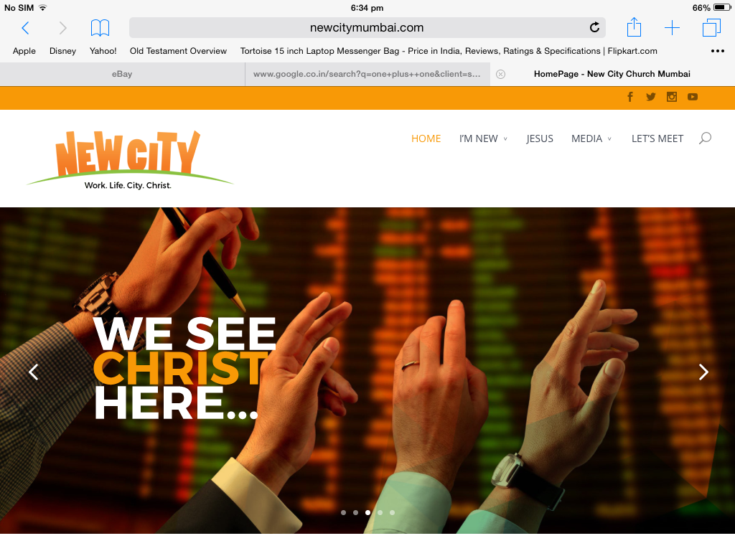

Slide 11
Come, follow me!
I send you into the world!

Slide 12
The problem is we forget we are 'called' to our careers

Slide 13
1) Mere fans of Jesus love their careers.
Followers love Jesus through their careers.

Slide 14
2) Someone who is just a fan of Jesus is always looking to TAKE from her career; a follower of Jesus always looks to GIVE through her career

Slide 15
The CHALLENGES of being in our careers

Slide 16
.
Holy Father, protect them by the power of your name, the name you gave me, so that they may be one as we are one. While I was with them, I protected them and kept them safe by that name you gave me. None has been lost except the one doomed to destruction so that Scripture would be fulfilled.
John 17:11-13 NIV

Slide 17
LOVE FOR CAREER
VS
LOVE FOR CHRIST

Slide 18
“For God so loved the world that he gave his one and only Son, that whoever believes in him shall not perish but have eternal life.”
John 3:16 NIV

Slide 19
“Do not love the world or anything in the world. If anyone loves the world, love for the Father is not in them..
1 John 2:15-17 NIV

Slide 20
God's love for the world is redemptive
Our love for the world can be idolatrous

Slide 21
The journey from being just a fan of Jesus to becoming a follower must involve a purging of our own idolatrous love for our careers and a growing in God's redemptive love for the world through our careers.

Slide 22
The CONFIDENCE to be in our careers

Slide 23
“Just as you sent me into the world, I am sending them into the world. And I give myself as a holy sacrifice for them so they can be made holy by your truth.”
John 17:18-19 NLT

Slide 24
Consider the timing and content of Jesus' prayer!!
He was arrested almost immediately after this prayer and was crucified soon after that.
I am sending them into the world, and I am going to the cross
Jesus sends us into the world and into our careers and He goes to the cross!!!

Slide 25
This process by which we learn to overcome our idolatrous love for our careers by constantly gazing at His redemptive love is how God sanctifies us through our careers.
My career is the crucible for my sanctification

Slide 26
Mere fans of Jesus will give into the idolatrous calling of their careers; true followers WILL experience Gospel power to overcome their idolatrous love for their careers.

Slide 27
THE CALL
Someone who is just a fan of Jesus is always looking to TAKE from her career; a follower of Jesus always looks to GIVE through her career
THE CHALLENGE
The journey from being just a fan of Jesus to becoming a follower must involve a purging of our idolatrous love for our careers and a growing in God's redemptive love for the world through our careers
THE CONFIDENCE
Mere fans of Jesus will give into the idolatrous calling of their careers; true followers WILL experience Gospel power to overcome their idolatrous love for their careers.

Slide 28
COMMUNION!
The table where we see His redemptive love and receive Gospel power to overcome our idolatrous love for our careers

Slide 29
1 Cor 11
23 The Lord Jesus, on the night he was betrayed, took bread, 24 and when he had given thanks, he broke it and said, “This is my body, which is for you; do this in remembrance of me.” 25 In the same way, after supper he took the cup, saying, “This cup is the new covenant in my blood; do this, whenever you drink it, in remembrance of me.” 26 For whenever you eat this bread and drink this cup, you proclaim the Lord’s death until he comes.

