Slide 2
...In this world you will have trouble....
John 16:33

Slide 3
...In this world you will have trouble.
But take heart! I have overcome the world.”
John 16:33

Slide 5
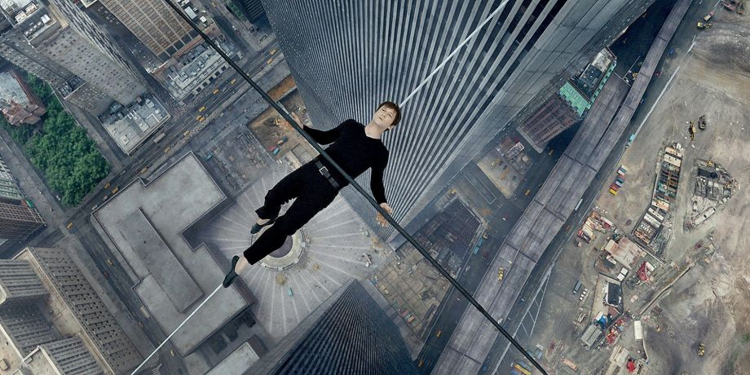

Slide 6
Romans 8:15-21
15 The Spirit you received does not make you slaves, so that you live in fear again; rather, the Spirit you received brought about your adoption to sonship.[a] And by him we cry, “Abba,[b] Father.” 16 The Spirit himself testifies with our spirit that we are God’s children. 17 Now if we are children, then we are heirs—heirs of God and co-heirs with Christ, if indeed we share in his sufferings in order that we may also share in his glory.

Slide 7
Romans 8:15-21
18 I consider that our present sufferings are not worth comparing with the glory that will be revealed in us.
19 For the creation waits in eager expectation for the children of God to be revealed. 20 For the creation was subjected to frustration, not by its own choice, but by the will of the one who subjected it, in hope 21 that[c] the creation itself will be liberated from its bondage to decay and brought into the freedom and glory of the children of God.

Slide 8
I consider that our present sufferings are not worth comparing with the glory that will be revealed in us.

Slide 9
Three things from the passage
1) The towering reality of hardship
2) The towering reality of hope
3) How we need to live in both realities

Slide 10
TOWERING REALITY OF HARDSHIP

Slide 11
¹⁸ I consider that our present sufferings are not worth comparing with the glory that will be revealed in us. ¹⁹ For the creation waits in eager expectation for the children of God to be revealed. ²⁰ For the creation was subjected to frustration, not by its own choice, but by the will of the one who subjected it, in hope ²¹ that the creation itself will be liberated from its bondage to decay and brought into the freedom and glory of the children of God. ²² We know that the whole creation has been groaning as in the pains of childbirth right up to the present time. ²³

Slide 12
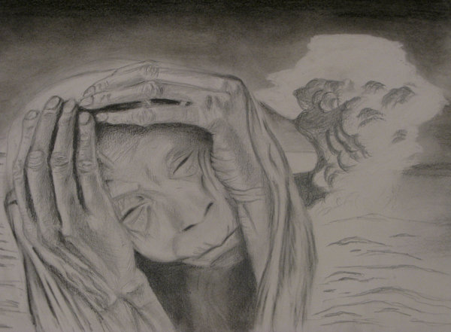
Suffering

Slide 13
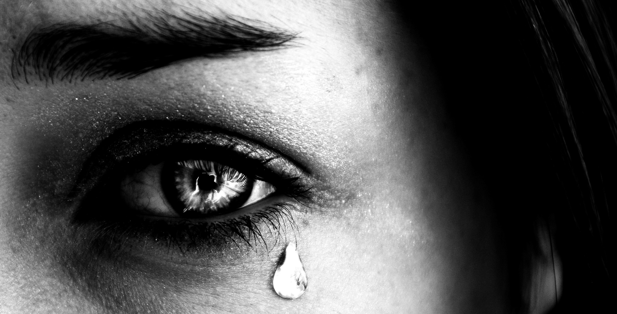
CHRIST is the only truly INNOCENT SUFFERER

Slide 14
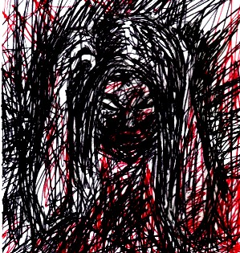
FRUSTRATION

Slide 15
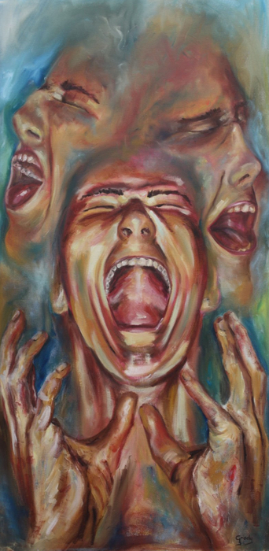
Groaning

Slide 16
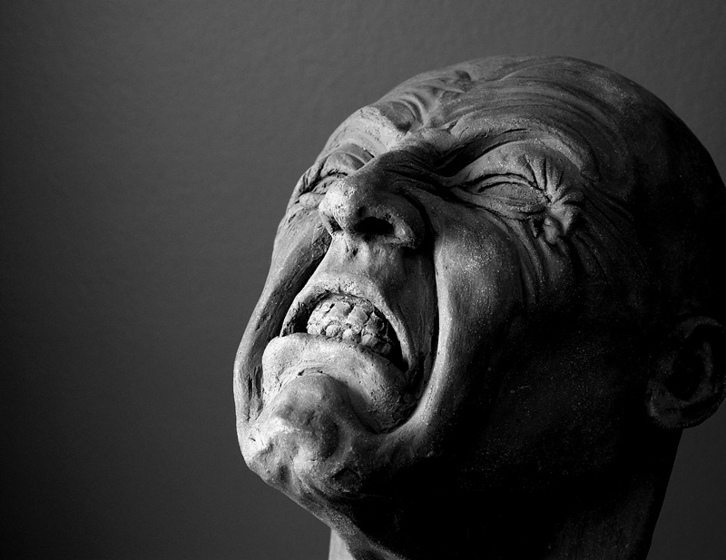
Groaning
Living in the city we rarely scream.
We mostly groan

Slide 17
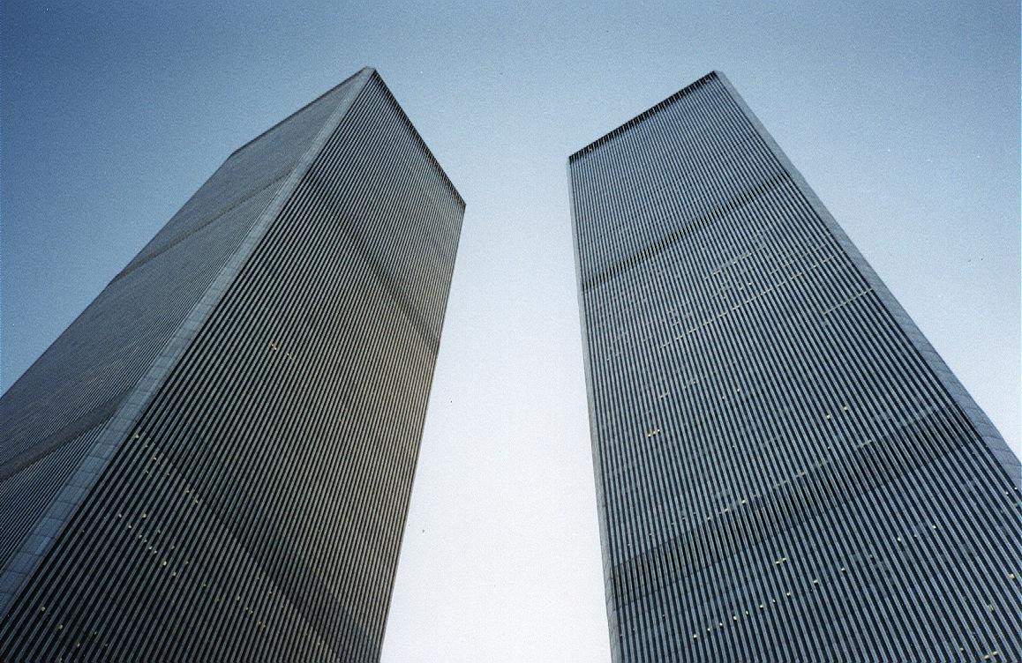
Romans 8:18
I consider that our present sufferings are not worth comparing with the glory that will be revealed in us.
The Hope of future glory
I consider that our present sufferings are not worth comparing with the glory that will be revealed in us.

Slide 18
TOWERING REALITY OF
HOPE

Slide 19
Frustration with the world
Frustration with self
Frustration with God

Slide 20
“For those God foreknew he also predestined to be conformed to the image of his Son...
Romans 8:29 NIV

Slide 21
Frustration with God is the sinful opposite of genuine repentance

Slide 22
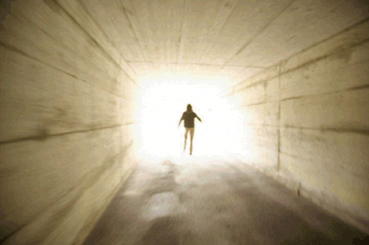
“For those God foreknew he also predestined to be conformed to the image of his Son... Romans 8:29 NIV
This is future glory: us transformed into the image and likeness of Christ Jesus!

Slide 23
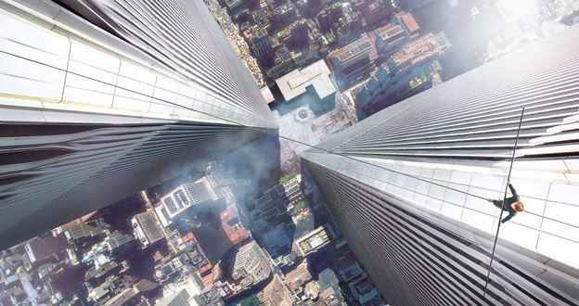

Slide 24
Romans 8:15-18
15 ......the Holy Spirit you received brought about your adoption to sonship. And by him we cry, “Abba, Father.” 16 The Spirit himself testifies with our spirit that we are God’s children.

Slide 26
33 “I have told you these things, so that in me you may have peace.
In this world you will have trouble. But take heart! I have overcome the world.”
John 16:33

Slide 27
The lord's super teaches us to celebrate both hardship and hope!

Slide 28
The Lord Jesus, on the night he was betrayed, took bread, 24 and when he had given thanks, he broke it and said, “This is my body, which is for you; do this in remembrance of me.” 25 In the same way, after supper he took the cup, saying, “This cup is the new covenant in my blood; do this, whenever you drink it, in remembrance of me.” 26 For whenever you eat this bread and drink this cup, you proclaim the Lord’s death until he comes.

