Slide 2
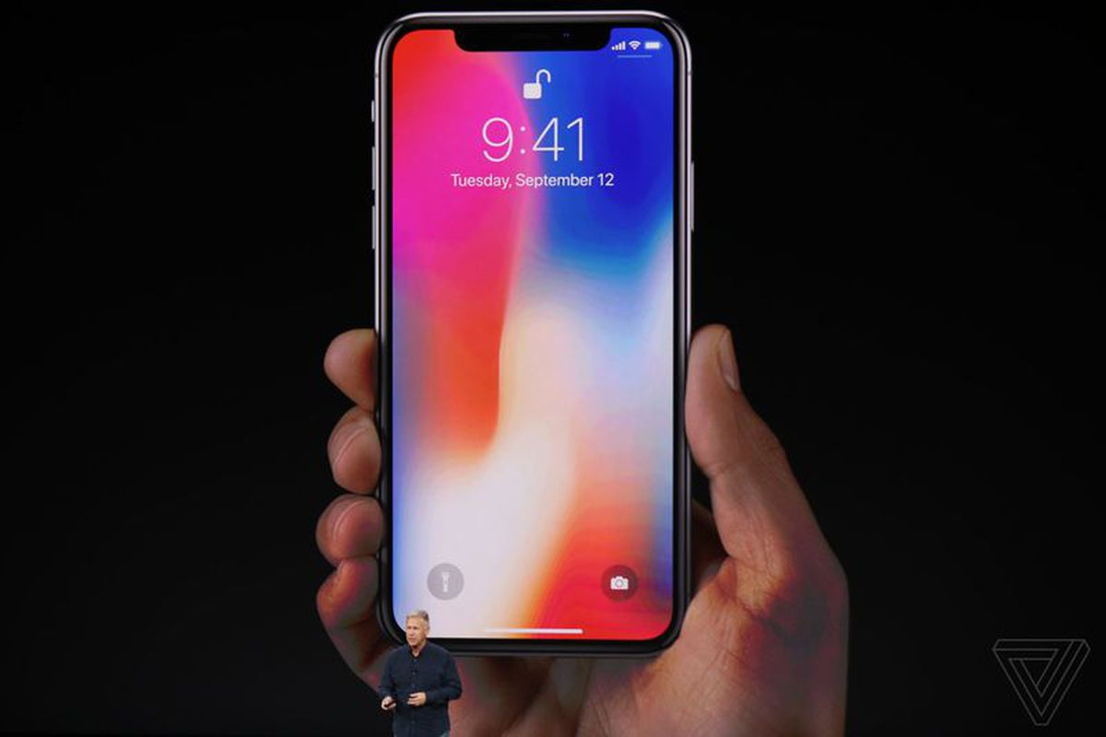

Slide 3
7 ATE 9

Slide 4
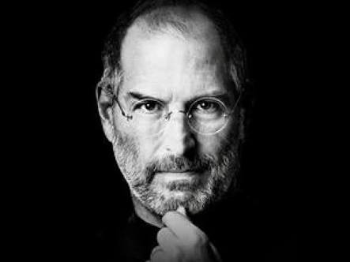

Slide 5
Arrogant.
Cold.
Rude.
Need for control.
Mood swings.
Emotional Volatility.

Slide 6
The Orphan Syndrome
We are adopted by God when we believe in Christ Jesus.
But we can continue living with an orphan mindset.

Slide 7
Romans 8:15-16
15 The Spirit you received does not make you slaves, so that you live in fear again; rather, the Spirit you received brought about your adoption to sonship. And by him we cry, “Abba,Father.”
16 The Spirit himself testifies with our spirit that we are God’s children.

Slide 8
1) Adoption

Slide 9
1) Adoption
2) Attachment

Slide 10
1) Adoption
2) Attachment
3) Introspection
4) Appreciation

Slide 11
1) Adoption

Slide 12
Adoption Through Propitiation

Slide 13
2) Attachment

Slide 14
Adoption happens in a moment.
Attachment can take months, even years.

Slide 15
It is possible for an adopted child to continue living in an
orphan mindset

Slide 16
Knowing God is our Father
and
Experiencing God as our Father
are two very different things

Slide 17
3) Introspection

Slide 18
1) Always Sad and Disheartened

Slide 19
2) Always Striving
for Success

Slide 20
3) Always a Rebel

Slide 21
1) Always Sad and Disheartened
2) Always Striving for Success
3) Always a Rebel

Slide 22
4) Appreciation

Slide 23
Romans 8:15-16
15 The Spirit you received does not make you slaves, so that you live in fear again; rather, the Spirit you received brought about your adoption to sonship. And by him we cry, “Abba, Father.”
16 The Spirit himself testifies with our spirit that we are God’s children.

Slide 24
The Holy Spirit coaches us through the process of being adopted by God and becoming more and more attached to Him.
He is a live-in coach.
He is the Resident

Slide 25
Romans 8:15-16
15 The Spirit you received does not make you slaves, so that you live in fear again; rather, the Spirit you received brought about your adoption to sonship.
And by him we cry, “Abba,Father.”
16 The Spirit himself testifies with our spirit that we are God’s children.

Slide 26
Abba, Father!

Slide 27
““Abba, Father,”
Jesus said, “everything is possible for you. Take this cup from me. Yet not what I will, but what you will.””
Mark 14:36

Slide 28
In borrowing the phrase
‘Abba, Father’ from Jesus,
the Holy Spirit is enabling us to have
the same intimacy and intensity of relationship
Jesus had with
His Father before He was crucified.

Slide 29
The Holy Spirit enables us to have the same intimacy
Jesus had with His Father.

Slide 30
“I didn't come from my
mummy's tummy;
I came from her heart.”

Slide 31
True faith in Jesus is like this.
It doesn't come from our mummy's tummy.
It comes from our heart.
The Holy Spirit helps us believe in Jesus.

