Slide 1
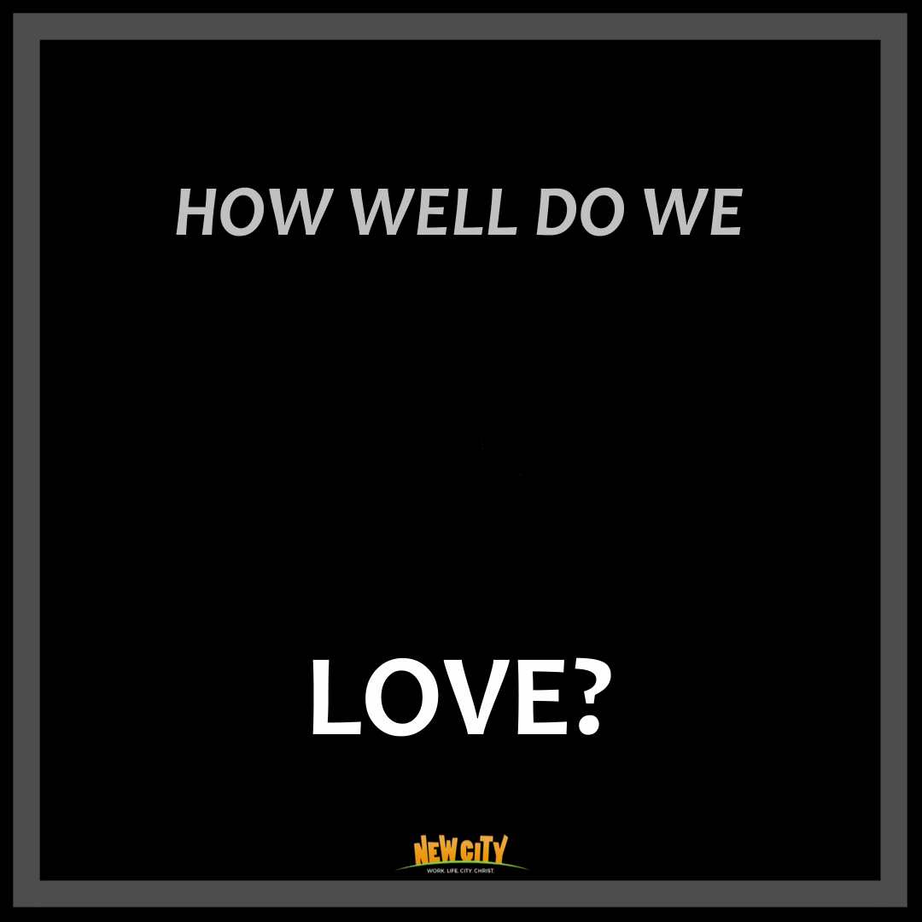

Slide 3
1 Cor 13
If I speak in the tongues of men or of angels, but do not have love, I am only a resounding gong or a clanging cymbal. ² If I have the gift of prophecy and can fathom all mysteries and all knowledge, and if I have a faith that can move mountains, but do not have love, I am nothing. ³ If I give all I possess to the poor and give over my body to hardship that I may boast, but do not have love, I gain nothing.

Slide 4
⁴ Love is patient, love is kind. It does not envy, it does not boast, it is not proud. ⁵ It does not dishonor others, it is not self-seeking, it is not easily angered, it keeps no record of wrongs. ⁶ Love does not delight in evil but rejoices with the truth. ⁷ It always protects, always trusts, always hopes, always perseveres.

Slide 5
Observation 1
Observation 2
The Perfect Portrait of Love

Slide 6
1. Worship is incomplete without loving and serving others

Slide 7
1 Cor 13:1-3
If I speak in the tongues of men or of angels, but do not have love, I am only a resounding gong or a clanging cymbal. ² If I have the gift of prophecy and can fathom all mysteries and all knowledge, and if I have a faith that can move mountains, but do not have love, I am nothing. ³ If I give all I possess to the poor and give over my body to hardship that I may boast, but do not have love, I gain nothing.

Slide 10
It is only in community that our gifts find their full and complete expression of worship.

Slide 11
2. The call to love involves a call to die

Slide 12
⁴ Love is patient and kind. Love is not jealous or boastful or proud ⁵ or rude. It does not demand its own way. It is not irritable, and it keeps no record of being wronged. ⁶ It does not rejoice about injustice but rejoices whenever the truth wins out. ⁷ Love never gives up, never loses faith, is always hopeful, and endures through every circumstance.
1 Cor 13: 4-7

Slide 13
LOVE DEFINED (1 COR 13)
BEING
DYING
Patient
&
Not Irritable
To the desire for a perfect & trouble-free life

Slide 14
LOVE DEFINED (1 COR 13)
NOT BEING
DYING
Jealous
To the desire for
Undivided Attention

Slide 15
LOVE DEFINED (1 COR 13)
NOT BEING
DYING
Boastful
Or
Proud
To the desire for
Attention to my Successes

Slide 16
LOVE DEFINED (1 COR 13)
NOT DEMANDING
DYING
My own ways
To the desire to be
in control of everything

Slide 17
LOVE DEFINED (1 COR 13)
NOT KEEPING
DYING
Record of wrongs
To the desire for
Revenge

Slide 18
LOVE DEFINED (1 COR 13)
DYING
Never giving up,
Losing faith
Being always hopeful,
Enduring every circumstance
To the desire to run away from suffering and painful obedience.

Slide 19
The call to love is not that of personal gratification but that of death. Death to self.

Slide 20
“There is no safe investment. To love at all is to be vulnerable. Love anything, and your heart will certainly be wrung and possibly be broken. If you want to make sure of keeping it intact, you must give your heart to no one, not even to an animal. Wrap it carefully round with hobbies and little luxuries; avoid all entanglements; lock it up safe in the casket or coffin of your selfishness.

Slide 21
But in that casket — safe, dark, motionless, airless – it will change. It will not be broken; it will become unbreakable, impenetrable, irredeemable. The alternative to tragedy, or at least to the risk of tragedy, is damnation. The only place outside Heaven where you can be perfectly safe from all the dangers and perturbations of love is Hell.”
– C S Lewis.

Slide 22
3. Perfect portrait of love

Slide 23
2 And so it was with me, brothers and sisters. When I came to you, I did not come with eloquence or human wisdom as I proclaimed to you the testimony about God. ² For I resolved to know nothing while I was with you except Jesus Christ and him crucified.
1 Cor 2: 1-2

Slide 24
Whoever does not love does not know God,
because God is love.
I John 4:8

Slide 25
God does not just love, he is not just the source of all love, but He is LOVE himself!!!

Slide 26
Love is patient and kind

Slide 27
Love is not jealous or boastful or proud

Slide 28
It does not demand its own way

Slide 29
It is not irritable

Slide 30
It keeps no record of being wronged

Slide 31
It does not rejoice about injustice

Slide 32
The Cross is not just the portrait of perfect love, but also the punishment for our lack of it!

Slide 33
The Cross is not just the portrait of perfect love, but also the punishment for our lack of it!
The Cross empowers us to die ourselves, and love others.

Slide 35
"I have forgiven the killers and have no bitterness because forgiveness brings healing and our land needs healing from hatred and violence…”
"God in Christ has forgiven me and expects His followers to do the same. The Bible says: "To whomsoever you forgive their sins will be forgiven". Therefore, in the light of eternity we all need forgiveness of our sins to enter heaven‘’
The Hindu | Sept 23, 2003

Slide 36
It is impossible to Love well, if we do not worship Jesus as the God who is Love himself.

Slide 37
We can love till it hurts today, knowing that one day perfect love will reign in our city, when Jesus returns.

