Slide 2
Self-awareness is having the clarity to see who we are irrespective of our environment

Slide 3
1. Sin in us will prevent us from taking a deep look
2. Hurt and fear is another big obstacle.
3. Having seen the sin or the mess inside, we hate to do the hard work of cleaning up the mess.

Slide 4
4. Sometimes it could be the fear that this mess or sin could lead to more mess. And I can’t deal with it.
5. Some of us may be thinking I don’t have time to deal with all this. Life goes on. What’s the point any way?

Slide 5
Luke 7:36 to 50
When one of the Pharisees invited Jesus to have dinner with him, he went to the Pharisee’s house and reclined at the table. 37 A woman in that town who lived a sinful life learned that Jesus was eating at the Pharisee’s house, so she came there with an alabaster jar of perfume. 38 As she stood behind him at his feet weeping, she began to wet his feet with her tears.

Slide 6
Then she wiped them with her hair, kissed them and poured perfume on them.
39 When the Pharisee who had invited him saw this, he said to himself, “If this man were a prophet, he would know who is touching him and what kind of woman she is—that she is a sinner.”

Slide 7
40 Jesus answered him, “Simon, I have something to tell you.”
“Tell me, teacher,” he said.
41 “Two people owed money to a certain moneylender. One owed him five hundred denarii,[a] and the other fifty. 42 Neither of them had the money to pay him back, so he forgave the debts of both. Now which of them will love him more?”

Slide 8
43 Simon replied, “I suppose the one who had the bigger debt forgiven.”
“You have judged correctly,” Jesus said.
44 Then he turned toward the woman and said to Simon, “Do you see this woman? I came into your house. You did not give me any water for my feet, but she wet my feet with her tears and wiped them with her hair.

Slide 9
45 You did not give me a kiss, but this woman, from the time I entered, has not stopped kissing my feet. 46 You did not put oil on my head, but she has poured perfume on my feet. 47 Therefore, I tell you, her many sins have been forgiven—as her great love has shown. But whoever has been forgiven little loves little.”
48 Then Jesus said to her, “Your sins are forgiven.”

Slide 10
49 The other guests began to say among themselves, “Who is this who even forgives sins?”
50 Jesus said to the woman, “Your faith has saved you; go in peace.”

Slide 11
1. Spiritual Arrogance Vs Spiritual Brokenness
2. Gospel Humility

Slide 12
Spiritual Arrogance Vs Spiritual Brokenness :

Slide 13
He was a proud self-sufficient man

Slide 14
Often times, pride pushes us away from
deep awe of God

Slide 15
Our Self-sufficiency will always question but never actually receive an answer.

Slide 16
Self-sufficient people generally do not look for a deep, revelatory or vulnerable relationship with God or with men. They are often scared of real friendships

Slide 17
Self-sufficiency and pride lead to spiritual arrogance. Spiritual arrogance will not allow us grow.

Slide 18
Spiritual arrogance will not enable us to depend on God but rather take us away from God.

Slide 19
We need to have honesty, courage and clarity to look within ourselves.

Slide 20
Unless we see and acknowledge our mess within, we will not feel the need for God.

Slide 21
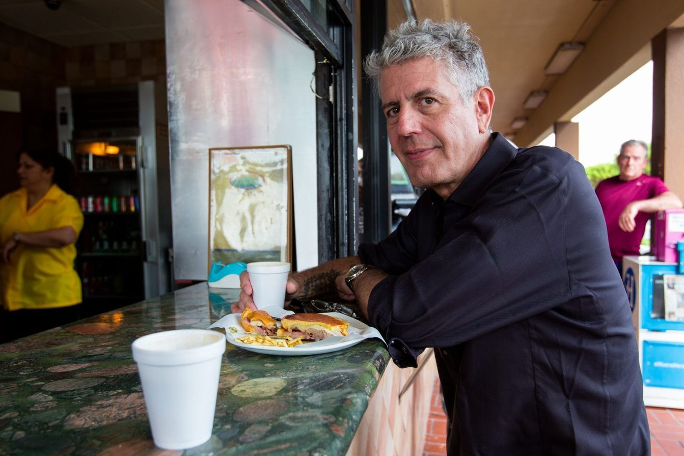

Slide 22
Apart from Jesus, very other good thing that we desire and adore has a shelf life. It is meant only for a season.

Slide 23
If you are an explorer of Christ, have you ever thought what’s beyond this life?, even after having many things in life, why am I not content? If you want to talk more about it, we are available.

Slide 24
2) Spiritual Brokenness:

Slide 25
Verse37, “when a woman who had lived a sinful life in that town learned that Jesus was eating at the Pharisee’s house, she brought an alabaster jar of perfume and stood behind him at his feet weeping.”
Verse 45, “from the time I entered, she has not stopped kissing my feet.”

Slide 26
She came prepared to meet Jesus! She came with an alabaster jar of perfume to pour on Jesus.

Slide 27
Spiritual brokenness never allow us to settle with sin but it coaches us to acknowledge our sin.

Slide 28
Simon, the religious leader failed to see or acknowledge his sin, but this sinful woman openly acknowledging her sin before the most judgmental and self-righteous crowd.

Slide 29
Who understood grace more?

Slide 30
The Gospel frees us and never condemns us. When we understand this, we will begin to enjoy spiritual humility with God and with community.

Slide 31
2. Gospel Humility

Slide 32
“Gospel-humility means I stop connecting every experience, every conversation with myself. In fact, I stop thinking about myself. The freedom of self-forgetfulness.”
-Tim Keller

Slide 33
Gospel humility sympathizes with sinners and never caste them away. Every time when Jesus saw the crowd he was moved with compassion

Slide 34
Gospel humility is staying true to Jesus and
to His calling and purposes

Slide 35
John 13: 4-8
“so he (Jesus) got up from the meal, took off his outer clothing, and wrapped a towel around his waist. 5 After that, he poured water into a basin and began to wash his disciples’ feet, drying them with the towel that was wrapped around him.
6 He came to Simon Peter, who said to him, “Lord, are you going to

Slide 36
wash my feet?”
7 Jesus replied, “You do not realize now what I am doing, but later you will understand.”
8 “No,” said Peter, “you shall never wash my feet.”
Jesus answered, “Unless I wash you, you have no part with me.”
6 He came to Simon Peter, who said to him, “Lord, are you going to wash my feet?”

Slide 37
His washing is our assurance that God the father will no longer will see us like sinners.
The father only sees us through the prism of Christ Jesus

