Slide 1
WAITING

Slide 2
My/Our Wait

Slide 3
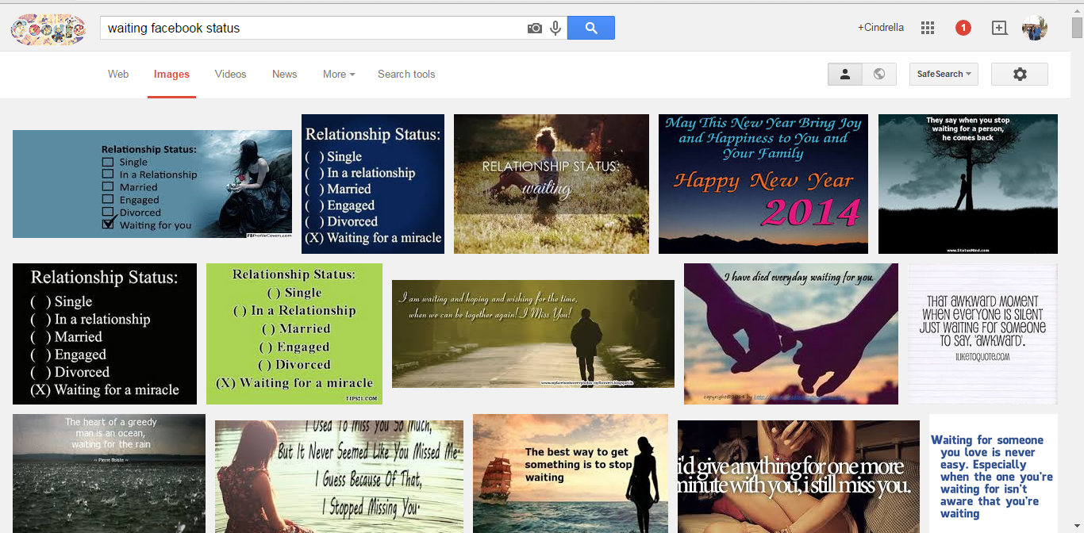
My/Our Wait

Slide 4
My/Our Wait
The Knowledge
We’re all waiting : for a job, for a relationship, for admissions, marriage, church etc.
Some of us know who/what we’re waiting for and some of us don’t
Some of us know when our wait would conclude and some of us don’t

Slide 5
My/Our Wait
The Heart Posture
Some times we occupy ourselves to distract our own selves from the frustration the wait is causing

Slide 6
Distraction
Priyanka Chopra resumed work 48 hours after her dad’s funeral, she said, “I don’t think it’s strength. I should have taken the time to deal with it. I wanted to run away from dealing with it and I did, I started work four days later, one, because my dad hated me sitting at home, and second, I would have lost my mind if I did…..so I went back to work because that was my only solace and I haven’t stopped since”.

Slide 7
My/Our Wait
The Heart Posture
Some times we wait so fabulously well that we surprise ourselves
Most times, we wait poorly

Slide 8
The Wise Men’s Wait
Matthew 2:1&2
After Jesus was born in Bethlehem village, Judah territory— this was during Herod’s kingship—a band of scholars arrived in Jerusalem from the East. They asked around, “Where can we find and pay homage to the newborn King of the Jews? We observed a star in the eastern sky that signaled his birth. We’re on pilgrimage to worship him.”
Notes:
The wise men didn’t wait for a baby to be born. They waited for the life of this baby.

Slide 9
The Wise Men’s Wait
Matthew 2:1&2
The Knowledge :
The ‘wise men’ had to wait for the birth of the Messiah
They knew fully well WHO they waited for
But they didn’t know WHEN their wait would end
Notes:
The wise men didn’t wait for a baby to be born. They waited for the life of this baby.

Slide 10
The Wise Men’s Wait
Matthew 2:9-11
Instructed by the king, they set off. Then the star appeared again, the same star they had seen in the eastern skies. It led them on until it hovered over the place of the child. They could hardly contain themselves: They were in the right place! They had arrived at the right time!
They entered the house and saw the child in the arms of Mary, his mother. Overcome, they kneeled and worshiped him. Then they opened their luggage and presented gifts: gold, frankincense, myrrh.
Notes:
The wise men didn’t wait for a baby to be born. They waited for the life of this baby.

Slide 11
The Wise Men’s Wait
Matthew 2:9-11
The heart posture:
They knew they were waiting for someone special and hence, didn’t mind following a star - faith
They came prepared for royalty – Gold
They came prepared for worship – Frankincense
They came prepared for the death – Myrrh
THEY WAITED, ACTIVELY!
THEY PREPARED AS THEY WAITED!
Notes:
The wise men didn’t wait for a baby to be born. They waited for the life of this baby.

Slide 12
Disciples’ Wait
Matthew 26 : 1&2, 20 – 30
When Jesus finished saying these things, he told his disciples, “You know that Passover comes in two days. That’s when the Son of Man will be betrayed and handed over for crucifixion.”
After sunset, he and the Twelve were sitting around the table. During the meal, he said, “I have something hard but important to say to you: One of you is going to hand me over to the conspirators.” They were stunned, and then began to ask, one after another, “It isn’t me, is it, Master?” Jesus answered, “The one who hands me over is someone I eat with daily, one who passes me food at the table. In one sense the Son of Man is entering into a way of treachery well-marked by the Scriptures—no surprises here. In another sense that man who turns him in, turns traitor to the Son of Man—better never to have been born than do this!”Then Judas, already turned traitor, said, “It isn’t me, is it, Rabbi?”
Notes:
Though their wait time was limited they forgot all about it

Slide 13
Disciples’ Wait
Jesus said, “Don’t play games with me, Judas.” The Bread and the Cup during the meal, Jesus took and blessed the bread, broke it, and gave it to his disciples: Take, eat. This is my body. Taking the cup and thanking God, he gave it to them: Drink this, all of you. This is my blood, God’s new covenant poured out for many people for the forgiveness of sins. “I’ll not be drinking wine from this cup again until that new day when I’ll drink with you in the kingdom of my Father.” They sang a hymn and went directly to Mount Olives
Notes:
Though their wait time was limited they forgot all about it

Slide 14
Disciples’ Wait
The Knowledge:
They knew the ENTIRE PLAN
The disciples knew Jesus like no other human being ever did
They had fore-knowledge - had to wait from ‘Good Friday’ till ‘Easter’…from the crucifixion till the resurrection – (John 2:19 - Jesus answered them, "Destroy this temple, and I will raise it again in three days”)
They knew exceptionally well WHO they waited for and WHEN their wait would end
Notes:
Though their wait time was limited they forgot all about it

Slide 15
Disciples’ Wait
Luke 24 : 1-12
¹⁻³ At the crack of dawn on Sunday, the women came to the tomb carrying the burial spices they had prepared. They found the entrance stone rolled back from the tomb, so they walked in. But once inside, they couldn’t find the body of the Master Jesus.
⁴⁻⁸ They were puzzled, wondering what to make of this. Then, out of nowhere it seemed, two men, light cascading over them, stood there. The women were awestruck and bowed down in worship. The men said, “Why are you looking for the Living One in a cemetery? He is not here, but raised up. Remember how he told you when you were still back in Galilee that he had to be handed over to sinners, be killed on a cross, and in three days rise up?” Then they remembered Jesus’ words.
⁹⁻¹¹ They left the tomb and broke the news of all this to the Eleven and the rest. Mary Magdalene, Joanna, Mary the mother of James, and the other women with them kept telling these things to the apostles, but the apostles didn’t believe a word of it, thought they were making it all up.
¹² But Peter jumped to his feet and ran to the tomb. He stooped to look in and saw a few grave clothes, that’s all. He walked away puzzled, shaking his head.
Notes:
Though their wait time was limited they forgot all about it

Slide 16
Disciples’ Wait
Luke 24:1-12
The heart posture:
They were sad and depressed
They went to embalm Jesus’ body
They forgot what they waited for
They forgot who they waited for
THEY WAITED POORLY

Slide 17
Resurrection
1st Corinthians 15: 14-19 : And if Christ has not been raised, our preaching is useless and so is your faith.¹⁵ More than that, we are then found to be false witnesses about God, for we have testified about God that he raised Christ from the dead. But he did not raise him if in fact the dead are not raised. ¹⁶ For if the dead are not raised, then Christ has not been raised either. ¹⁷ And if Christ has not been raised, your faith is futile; you are still in your sins.¹⁸ Then those also who have fallen asleep in Christ are lost.¹⁹ If only for this life we have hope in Christ, we are of all people most to be pitied.

Slide 18
Why the change?
Acts 1:4 ⁴ On one occasion, while Jesus was eating with them, He gave them this command: “Do not leave Jerusalem, but wait for the gift my Father promised, which you have heard me speak about.⁵ For John baptized with water, but in a few days you will be baptized with the Holy Spirit.”

Slide 19
God’s Wait
Ephesians 1:3-6
³⁻⁶ How blessed is God! And what a blessing he is! He’s the Father of our Master, Jesus Christ, and takes us to the high places of blessing in him. Long before he laid down earth’s foundations, he had us in mind, had settled on us as the focus of his love, to be made whole and holy by his love. Long, long ago he decided to adopt us into his family through Jesus Christ. (What pleasure he took in planning this!) He wanted us to enter into the celebration of his lavish gift-giving by the hand of his beloved Son.
Since before creation till Christ’ crucifixion, God waited

Slide 20
God’s Wait
God waits for us to believe that the Gospel redeems every wait of our life
Job – the Gospel gives us security in the finished work of the cross
Education – the Gospel gives us an identity irrespective of our degrees or lack of it thereof
Relationship/Marriage – the Gospel ensures we’re His Bride already…irrespective of whether we’re married, single, divorced, troubled in marriage etc.
Church – the Gospel redeems our inanimate building and calls US the church instead
Why not believe and/or apply the Gospel of Jesus Christ to our very wait today?

Slide 21
God’s Wait
Mark 16:14-16
¹⁴⁻¹⁶ Still later, as the Eleven were eating supper, he appeared and took them to task most severely for their stubborn unbelief, refusing to believe those who had seen him raised up. Then he said, “Go into the world. Go everywhere and announce the Message of God’s good news to one and all. Whoever believes and is baptized is saved; whoever refuses to believe is damned.
God is waiting for us. Present continuous.

Slide 22
When we arrive at eternity's shore Where death is just a memory and tears are no more We'll enter in as the wedding bells ring Your bride will come together and we'll sing You're beautiful
- Phil Wickham

Slide 23
ETERNAL WEDDING
Christ waits for His Bride : her sanctification
Romans 2:4
⁴ Or do you show contempt for the riches of His kindness, forbearance and patience, not realizing that God’s kindness is intended to lead you to repentance?

Slide 24
ETERNAL WEDDING
Christ waits for His Father to tell him to go get her
Matthew 24:36
³⁶ “But about that day or hour no one knows, not even the angels in heaven, nor the Son, but only the Father.

Slide 25
How To Wait Well?
Preach to our soul : dead to our physical eyes is just ‘waiting’ in God’s scheme of things
Community : when we know we’re not the only ones waiting, it’s redeeming! We can pray and play through our frustrations. Instead of distracting ourselves from the wait, a community helps us focus on God – ultimately the One we’re waiting for – GAP groups
Solo time : I cannot labor on this enough. Apart from the start of eternity, Jesus waited for 30 more years of His life before He began the freeing work of salvation amongst us. No one knows how annoying and irritating it could be, better than Jesus – CBR

Slide 26
Ultimately
We might all be waiting on different things, but allow me to remind us that we are actually just waiting on GOD.

Slide 27
To sum up…
“I realized that the deepest spiritual lessons are not learned by His letting us have our way in the end, but by His making us wait, bearing with us in love and patience until we are able to honestly pray what He taught His disciples to pray: Thy will be done.”
– Elisabeth Elliott

