Slide 1
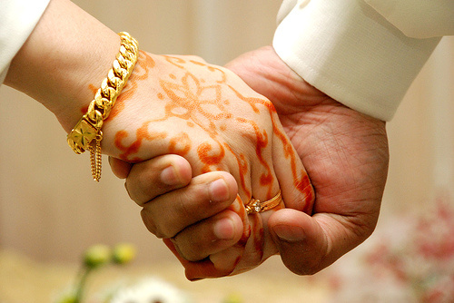
A Single's
Guide to
Marriage

Slide 2
“Submit to one another out of reverence for Christ. Wives, submit yourselves to your own husbands as you do to the Lord. For the husband is the head of the wife as Christ is the head of the church, his body, of which he is the Savior. Now as the church submits to Christ, so also wives should submit to their husbands in everything. Husbands, love your wives, just as Christ loved the church and gave himself up for her to make her holy, cleansing her by the washing with water through the word, and to present her to himself as a radiant church, without stain or wrinkle or any other blemish, but holy and blameless.
Ephesians 5:21-33 NIV

Slide 3
In this same way, husbands ought to love their wives as their own bodies. He who loves his wife loves himself. After all, no one ever hated their own body, but they feed and care for their body, just as Christ does the church— for we are members of his body. “For this reason a man will leave his father and mother and be united to his wife, and the two will become one flesh.”
Ephesians 5:21-33 NIV

Slide 4
This is a profound mystery—but I am talking about Christ and the church. However, each one of you also must love his wife as he loves himself, and the wife must respect her husband.”
Ephesians 5:21-33 NIV

Slide 5
Romantic View
Cynical View

Slide 6
Romantic View of Marriage

Slide 7
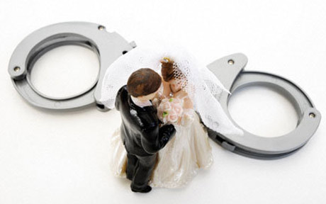
Cynical View of Marriage

Slide 8
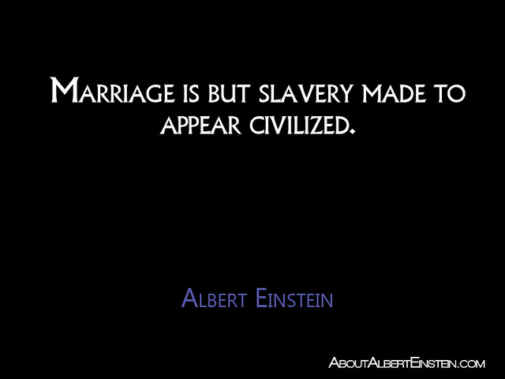
Cynical View of Marriage

Slide 9
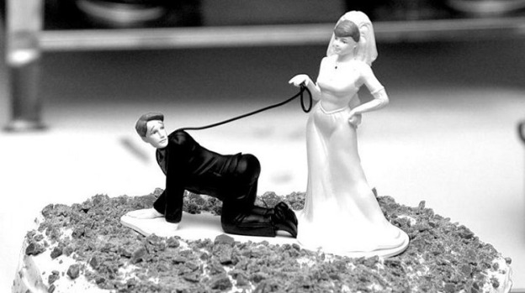
Cynical View of Marriage

Slide 10
Cynical View of Marriage

Slide 11
A romantic view of marriage will lead to many disappointments in life
A cynical view of marriage will cause you to miss some of the greatest joys in life

Slide 12
Wrong Hopes
Wrong Fears

Slide 13
Our view of marriage is unreasonably romantic when we cherish WRONG HOPES
Our view of marriage is unneccesarily cynical when we grapple with WRONG FEARS

Slide 14
Wrong Hopes

Slide 15
Wrong Fears

Slide 16
Wrong Hopes - Will I get enough?
Wrong Fears - Will I give away too much?

Slide 17
AT THE CENTRE OF BOTH THESE QUESTIONS IS
I

Slide 18
'I' as a starting point in marriage always spells trouble
Your marriage is never just about you
The best posture to come to marriage in is how can I love and serve YOU

Slide 19
YOU
I

Slide 20
I
I

Slide 21
“Submit to one another out of reverence for Christ. Wives, submit yourselves to your own husbands as you do to the Lord. For the husband is the head of the wife as Christ is the head of the church, his body, of which he is the Savior. Now as the church submits to Christ, so also wives should submit to their husbands in everything. Husbands, love your wives, just as Christ loved the church and gave himself up for her to make her holy, cleansing her by the washing with water through the word, and to present her to himself as a radiant church, without stain or wrinkle or any other blemish, but holy and blameless.
Ephesians 5:21-33 NIV

Slide 22
In this same way, husbands ought to love their wives as their own bodies. He who loves his wife loves himself. After all, no one ever hated their own body, but they feed and care for their body, just as Christ does the church— for we are members of his body. “For this reason a man will leave his father and mother and be united to his wife, and the two will become one flesh.”
Ephesians 5:21-33 NIV

Slide 23
This is a profound mystery—but I am talking about Christ and the church. However, each one of you also must love his wife as he loves himself, and the wife must respect her husband.”
Ephesians 5:21-33 NIV

Slide 24
1. Marriage is submission
2. Marriage is sacrifice
3. Marriage is a signpost

Slide 25
1. Marriage is submission

Slide 26
“Submit to one another out of reverence for Christ. Wives, submit yourselves to your own husbands as you do to the Lord. For the husband is the head of the wife as Christ is the head of the church, his body, of which he is the Savior. Now as the church submits to Christ, so also wives should submit to their husbands in everything. Husbands, love your wives, just as Christ loved the church and gave himself up for her to make her holy, cleansing her by the washing with water through the word, and to present her to himself as a radiant church, without stain or wrinkle or any other blemish, but holy and blameless.
Ephesians 5:21-33 NIV

Slide 27
“Submit to one another out of reverence for Christ. Wives, submit yourselves to your own husbands as you do to the Lord. For the husband is the head of the wife as Christ is the head of the church, his body, of which he is the Savior. Now as the church submits to Christ, so also wives should submit to their husbands in everything. Husbands, love your wives, just as Christ loved the church and gave himself up for her to make her holy, cleansing her by the washing with water through the word, and to present her to himself as a radiant church, without stain or wrinkle or any other blemish, but holy and blameless.
Ephesians 5:21-33 NIV

Slide 28
Christ!
Husband
Wife

Slide 29
Joyful, mutual submission is a beautiful expression of love

Slide 30
Difference between being submissive and being subservient

Slide 31
2. Marriage is sacrifice

Slide 32
Husbands, love your wives, just as Christ loved the church and gave himself up for her...
Ephesians 5:21-33 NIV

Slide 33
This passage leaves the husband with only one authority through which to express his leadership over his wife - S A C R I F I C E

Slide 34
When the sparks fly...
When the chemistry comes alive...

Slide 35
1. Marriage is submission
2. Marriage is sacrifice

Slide 36
3. Marriage is a signpost

Slide 37
3. Marriage is only a signpost.
It's not the real thing!

Slide 38
The signpost called marriage is important for us to grow in our experience of the Gospel.

Slide 39
You are beautiful and attractive now.
But when we get married, I will see all your flaws and ugliness.
I promise to love you nonetheless.
I promise to love you at my expense.
I promise to love you laying down my life for yours.

Slide 40
We will all break this promise.
Only one man has kept this promise.
Christ Jesus!

Slide 41
Repent of our romantic view of marriage
Repent of our cynical view of marriage
Come to the communion asking God to help us be Christ like in our marriage.....

Slide 42
“...The Lord Jesus, on the night he was betrayed, took bread, and when he had given thanks, he broke it and said, “This is my body, which is for you; do this in remembrance of me.”
In the same way, after supper he took the cup, saying, “This cup is the new covenant in my blood; do this, whenever you drink it, in remembrance of me.”
For whenever you eat this bread and drink this cup, you proclaim the Lord’s death until he comes.”
1 Corinthians 11:23-26

