Slide 2
Romans 6:1-11 Well then, should we keep on sinning so that God can show us more and more of his wonderful grace? 2 Of course not! Since we have died to sin, how can we continue to live in it? 3 Or have you forgotten that when we were joined with Christ Jesus in baptism, we joined him in his death? 4 For we died and were buried with Christ by baptism. And just as Christ was raised from the dead by the glorious power of the Father, now we also may live new lives.

Slide 3
5 Since we have been united with him in his death, we will also be raised to life as he was. 6 We know that our old sinful selves were crucified with Christ so that sin might lose its power in our lives. We are no longer slaves to sin. 7 For when we died with Christ we were set free from the power of sin. 8 And since we died with Christ, we know we will also live with him. 9 We are sure of this because Christ was raised from the dead, and he will never die again. Death no longer has any power over him. 10 When he died, he died once to break the power of sin. But now that he lives, he lives for the glory of God. 11 So you also should consider yourselves to be dead to the power of sin and alive to God through Christ Jesus.

Slide 4
What is baptism?
Who is Paul preaching baptism to?
Why is he preaching baptism?

Slide 5
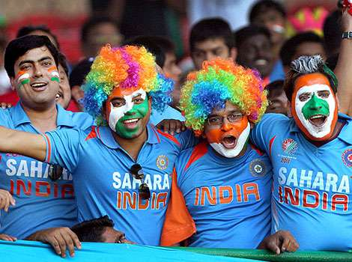

Slide 6
Baptism is an outward demonstration of a deep internal desire to imitate Christ. Baptism is an outward demonstration of a deep internal desire to identify with Christ….even unto His death and resurrection.

Slide 7
1) Baptism is being joined with Christ. 3 Or have you forgotten that when we were joined with Christ Jesus in baptism, we joined him in his death?

Slide 8
Baptism is an expression of complete commitment to Christ

Slide 9
2) Baptism is dying with Christ 3 – When we were joined with Christ in baptism we joined him in His death. 4 – For we died and were buried with Christ by baptism 5 – Since we have been united with Christ in His death 7 – For when we died with Christ….

Slide 10
3) Baptism is rising again with Christ 5 – Since we have been united with Him in His death, we will also be raised to life as He was. 8 – And since we died with Christ, we know we will also live with Him.

Slide 11
The symbolic death we die with Christ in our baptism is just a gateway to the glorious resurrected life we will enjoy in Christ!

Slide 12
2) Who is Paul preaching Baptism to?

Slide 13
PAUL IS PREACHING ABOUT BAPTISM TO PEOPLE WHO HAVE ALREADY BEEN BAPTISED!!!!!!!!

Slide 14
3 Or have you forgotten that when we were joined with Christ Jesus in baptism, we joined him in his death?

Slide 15
6 Well then, should we keep on sinning so that God can show us more and more of his wonderful grace?

Slide 16
PAUL IS PREACHING BAPTISM TO PEOPLE WHO HAVE A DESIRE TO OVERCOME SIN, BUT ARE SEEMINGLY UNBALE TO FIND THE POWER TO DO SO

Slide 17
3) Why is Paul preaching baptism to those who have already been baptised?

Slide 18
Paul is pointing to baptism to show us where to find the power to become better people!

Slide 19
7 For when we died with Christ (in baptism) we were set free from the power of sin.

Slide 20
Paul is saying this power to change is to be found in our faith that led us into the waters of baptism in the first place.

Slide 21
Rom 4:25 He was delivered over to death for our sins and was raised to life for our justification.

Slide 22
Just as He didn’t have to die, so He didn’t have to be baptized — until He became the bearer of all our sins. This He did by coming to earth for us. Billy Graham

