Slide 3
Today’s Talk Framework
Discuss stand out moments in Peter’s life
Dissect one incident between Jesus and Peter
Understand the call to be ‘Transformissional’

Slide 4
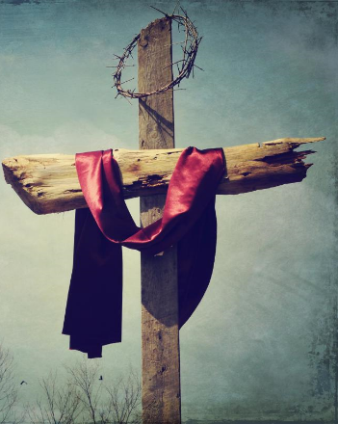
Journey of Peter
The Call
The Repentant Peter
The Tranformissional Call
The Fisherman
The Rebuke
The Betrayal

Slide 5
John 21:15-19

Slide 6
John 21:15-19 Jesus Reinstates Peter ¹⁵ When they had finished eating, Jesus said to Simon Peter, “Simon son of John, do you love me more than these?” “Yes, Lord,” he said, “you know that I love you.” Jesus said, “Feed my lambs.”

Slide 7
TRANFORMISSIONAL

Slide 8
¹⁶ Again Jesus said, “Simon son of John, do you love me?” He answered, “Yes, Lord, you know that I love you.” Jesus said, “Take care of my sheep.”

Slide 9
¹⁷ The third time he said to him, “Simon son of John, do you love me?” Peter was hurt because Jesus asked him the third time, “Do you love me?” He said, “Lord, you know all things; you know that I love you.” Jesus said, “Feed my sheep.

Slide 10
¹⁸ Very truly I tell you, when you were younger you dressed yourself and went where you wanted; but when you are old you will stretch out your hands, and someone else will dress you and lead you where you do not want to go.” ¹⁹ Jesus said this to indicate the kind of death by which Peter would glorify God. Then he said to him, “Follow me!”

Slide 11
TRANFORMISSIONED PETER

Slide 12
Journey of Peter
The Martyr
The Apostle
The Repentant Peter
The Reinstatement
The Betrayal

Slide 13
1) First PUBLIC confession about Christ 2) PILLAR of the first church 3) Crucified UPSIDE DOWN

Slide 14
First Thing Christ Told Peter FOLLOW ME Last Thing Christ Told Peter FOLLOW ME

Slide 15
BEING TRANFORMISSIONAL MEANS BEING FAITHFUL AND FAITH FULL

