Slide 2
Saul the
Persecutor of
Christ
Paul the Prisoner for Christ

Slide 3
Paul’s encouragement to the Ephesians
God’s plan to redeem those believers wove into God’s work in Paul’s life…
His suffering is for their benefit…
And he prays for them…

Slide 4
Today’s Passage: Ephesians 3:14-21
¹⁴ For this reason I kneel before the Father, ¹⁵ from whom every family^{[a]} in heaven and on earth derives its name.
¹⁶ I pray that out of his glorious riches he may strengthen you with power through his Spirit in your inner being, ¹⁷ so that Christ may dwell in your hearts through faith.
And I pray that you, being rooted and established in love, ¹⁸ may have power, together with all the Lord’s holy people, to grasp how wide and long and high and deep is the love of Christ, ¹⁹ and to know this love that surpasses knowledge—that you may be filled to the measure of all the fullness of God.

Slide 5
Today’s Passage: Ephesians 3:14-21
²⁰ Now to him who is able to do immeasurably more than all we ask or imagine, according to his power that is at work within us, ²¹ to him be glory in the church and in Christ Jesus throughout all generations, for ever and ever! Amen.

Slide 6
Today’s Talk Framework
Source of our encouragement
Basis of our encouragement
Result of our encouragement

Slide 7
Source of our encouragement

Slide 8
When discouragement comes…
Our thought life takes a big hit
We allow discouragement to ‘dwell in our hearts’
No strength to break the trend of negative self-talk

Slide 9
Source of our encouragement
God’s strengthening your inner being through His Spirit, so that Christ may dwell in our hearts through faith…

Slide 10
Source of our encouragement
Our encouragement must always come through God at work in our inner being and not through changed circumstances!

Slide 11
Basis of our encouragement

Slide 12
Basis of our encouragement
And I pray that you, being rooted and established in love, may have power together with all the Lord’s holy people to grasp how wide and long and high and deep is the love of Christ…

Slide 13
Basis of our encouragement
Being rooted and established in God’s love is a pre-requisite to experiencing God’s power
Even in the prison of discouragement, the love of God can always make its way through to us

Slide 14
Basis of our encouragement
And I pray that you, being rooted and established in love, may have power TOGETHER with all the Lord’s holy people to grasp how wide and long and high and deep is the love of Christ…

Slide 15
Basis of our encouragement
Encouragement of every person in our community is a community exercise, not merely an individual pursuit…
As we experience the love of God in community, we move from discouragement to encouragement
Grasping the dimensions of Christ’s love can never happen outside a Christ loving community

Slide 16
Result of our encouragement

Slide 17
Result of our encouragement
Now to him who is able to do immeasurably more than all we ask or imagine, according to his power that is at work within us, to him be glory in the church and in Christ Jesus throughout all generations…

Slide 18
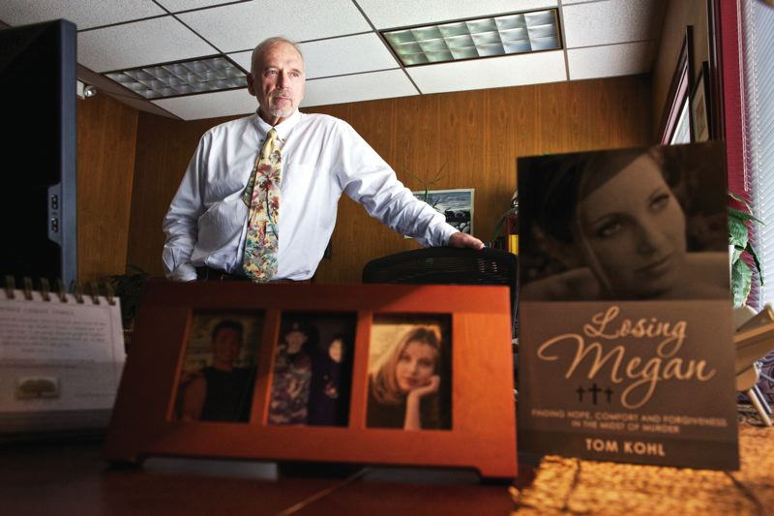
Story of encouragement

Slide 19
Judge Tom Kohl - Quote
“I have seen others who have ended up being very bitter and angry and resentful. And it just destroys them. It just destroys you from the inside out. And I was really blessed that I didn’t go through that.”
“The only way I got through that was because of the faith I had” he says…

Slide 20
Judge Tom Kohl - Quote
‘It wasn’t me. It was Jesus inside of me that was being kind.”

Slide 21
Some questions!!!
Do you have an anchor?
Is your anchor holding?
Are you losing yourself in trying to achieve these anchors?

Slide 22
An Anchor
The world offers us anchors at the cost of our lives…
Christ offers us an anchor at the cost of his life
Christ our eternal anchor

Slide 23
Overcoming discouragement
Love of Christ experienced in community empowers us to move from discouragement to encouragement.
Inside job that God does in our hearts: Mutually exclusive of our circumstances but fully intertwined with community

Slide 24
Continuous encouragement
God
Fullness
of God
Us
Community
We can be super achievers in Christ…..

Slide 25
Now to him who is able to do immeasurably more than all we ask or imagine, according to his power that is at work within us, to him be glory in the church and in Christ Jesus throughout all generations…

