Slide 1


Slide 2
5 Now Naaman was commander of the army of the king of Aram. He was a great man in the sight of his master and highly regarded, because through him the Lord had given victory to Aram. He was a valiant soldier, but he had leprosy.

Slide 3
² Now bands of raiders from Aram had gone out and had taken captive a young girl from Israel, and she served Naaman’s wife. ³ She said to her mistress, “If only my master would see the prophet who is in Samaria! He would cure him of his leprosy.”

Slide 4
⁴ Naaman went to his master and told him what the girl from Israel had said. ⁵ “By all means, go,” the king of Aram replied. “I will send a letter to the king of Israel.” So Naaman left, taking with him ten talents of silver, six thousand shekels of gold and ten sets of clothing.

Slide 5
⁶ The letter that he took to the king of Israel read: “With this letter I am sending my servant Naaman to you so that you may cure him of his leprosy.”

Slide 6
⁷ As soon as the king of Israel read the letter, he tore his robes and said, “Am I God? Can I kill and bring back to life? Why does this fellow send someone to me to be cured of his leprosy? See how he is trying to pick a quarrel with me!”

Slide 7
⁸ When Elisha the man of God heard that the king of Israel had torn his robes, he sent him this message: “Why have you torn your robes? Have the man come to me and he will know that there is a prophet in Israel.”

Slide 8
⁹ So Naaman went with his horses and chariots and stopped at the door of Elisha’s house.
¹⁰ Elisha sent a messenger to say to him, “Go, wash yourself seven times in the Jordan, and your flesh will be restored and you will be cleansed.”

Slide 9
¹¹ But Naaman went away angry and said, “I thought that he would surely come out to me and stand and call on the name of the Lord his God, wave his hand over the spot and cure me of my leprosy.

Slide 10
¹² Are not Abana and Pharpar, the rivers of Damascus, better than all the waters of Israel? Couldn’t I wash in them and be cleansed?” So he turned and went off in a rage.

Slide 11
¹³ Naaman’s servants went to him and said, “My father, if the prophet had told you to do some great thing, would you not have done it? How much more, then, when he tells you, ‘Wash and be cleansed’!”

Slide 12
¹⁴ So he went down and dipped himself in the Jordan seven times, as the man of God had told him, and his flesh was restored and became clean like that of a young boy.

Slide 13
¹⁵ Then Naaman and all his attendants went back to the man of God. He stood before him and said, “Now I know that there is no God in all the world except in Israel. So please accept a gift from your servant.”

Slide 14
¹⁶ The prophet answered, “As surely as the Lord lives, whom I serve, I will not accept a thing.” And even though Naaman urged him, he refused.

Slide 15
¹⁷ “If you will not,” said Naaman, “please let me, your servant, be given as much earth as a pair of mules can carry, for your servant will never again make burnt offerings and sacrifices to any other god but the Lord.

Slide 16
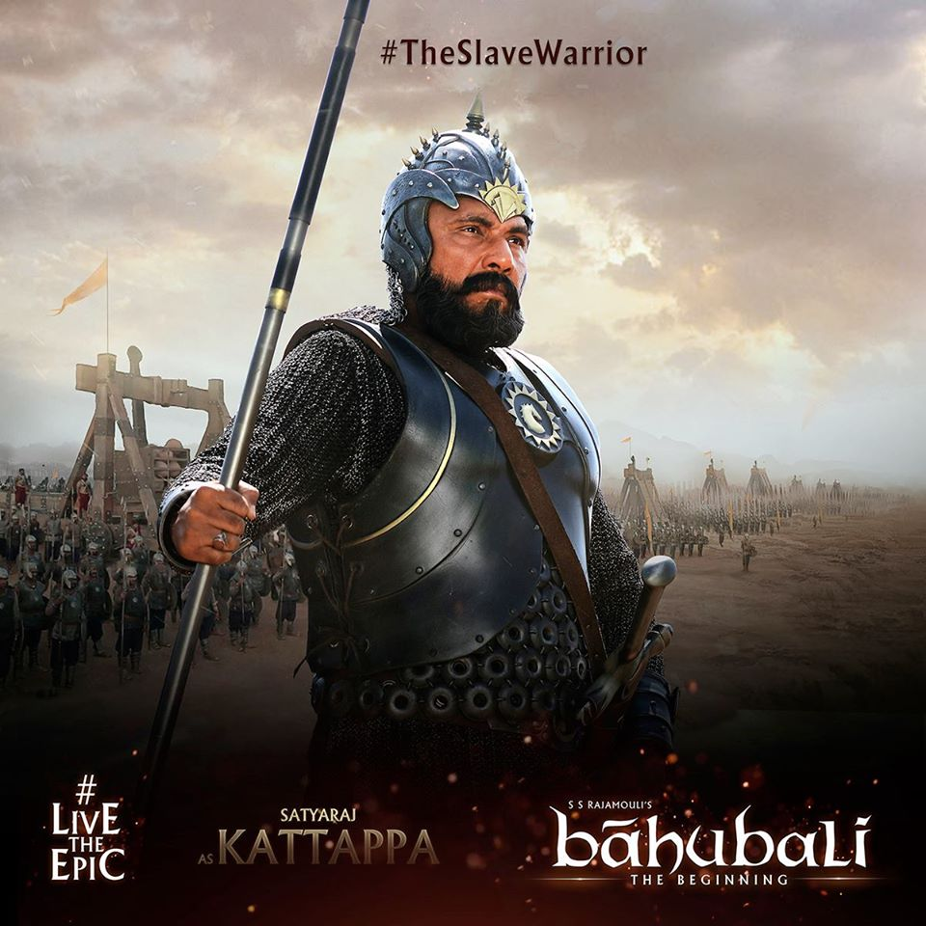

Slide 17
“Great! … But,”
“I thought…”
“The Lord!”

Slide 18
“Great! … But,”

Slide 19
Your description?
__________ but, __________

Slide 20
5 Now Naaman was commander of the army of the king of Aram. He was a great man in the sight of his master and highly regarded, because through him the Lord had given victory to Aram. He was a valiant soldier,

Slide 21
He was a great man in the sight of his master and highly regarded, because through him the Lord had given victory to Aram. He was a valiant soldier,

Slide 22
He was a valiant soldier, but he had leprosy.

Slide 23
So Naaman left, taking with him ten talents of silver, six thousand shekels of gold and ten sets of clothing.

Slide 24
¹⁰ Elisha sent a messenger to say to him, “Go, wash yourself seven times in the Jordan, and your flesh will be restored and you will be cleansed.”

Slide 25
“I thought”

Slide 26
¹¹ But Naaman went away angry and said, “I thought that he would surely come out to me and stand and call on the name of the Lord his God, wave his hand over the spot and cure me of my leprosy.

Slide 27
¹² Are not Abana and Pharpar, the rivers of Damascus, better than all the waters of Israel? Couldn’t I wash in them and be cleansed?” So he turned and went off in a rage.

Slide 28
¹³ Naaman’s servants went to him and said, “My father, if the prophet had told you to do some great thing, would you not have done it? How much more, then, when he tells you, ‘Wash and be cleansed’!”

Slide 29
“The Lord!”

Slide 30
¹⁷ “If you will not,” said Naaman, “please let me, your servant, be given as much earth as a pair of mules can carry, for your servant will never again make burnt offerings and sacrifices to any other god but the Lord.

Slide 31
Pride is failing to recognise that the only good in us is Jesus!

Slide 32
The Simplicity of the Gospel melts our pride;
Its depth demands our devotion.

