Slide 2
Romans 13:8-10
8 Let no debt remain outstanding, except the continuing debt to love one another, for whoever loves others has fulfilled the law. 9 The commandments, “You shall not commit adultery,” “You shall not murder,” “You shall not steal,” “You shall not covet,” and whatever other command there may be, are summed up in this one command: “Love your neighbor as yourself.” 10 Love does no harm to a neighbor. Therefore, love is the fulfillment of the law.

Slide 3
Romans 13:8-10
8 Let no debt remain outstanding, except the continuing debt to love one another, for whoever loves others has fulfilled the law. 9 The commandments, “You shall not commit adultery,” “You shall not murder,” “You shall not steal,” “You shall not covet,” and whatever other command there may be, are summed up in this one command: “Love your neighbor as yourself.” 10 Love does no harm to a neighbor. Therefore, love is the fulfillment of the law.

Slide 4
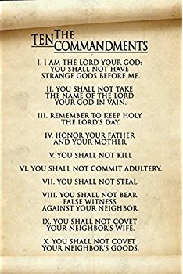
Romans 13:8-10
8 Let no debt remain outstanding, except the continuing debt to love one another, for whoever loves others has fulfilled the law. 9 The commandments, “You shall not commit adultery,” “You shall not murder,” “You shall not steal,” “You shall not covet,” and whatever other command there may be, are summed up in this one command: “Love your neighbor as yourself.” 10 Love does no harm to a neighbor. Therefore, love is the fulfillment of the law.

Slide 5
1. Love is a continuing debt: Why? 2. Love is the fulfillment of the law: How? 3. Love your neighbor as yourself: How?

Slide 6
1) Love is a continuing debt: Why?

Slide 8
Paul said… Love is a continuing debt out of a deep sense of gratitude for the love he had received from Christ…

Slide 9
Love I show to my neigbhor isn’t a favour that I am doing the person, but a response to the love and forgiveness, I have received from Christ.

Slide 10
2) Love is the fulfillment of the Law: How?

Slide 11
Matthew 22:37-38
Jesus replied: “‘Love the Lord your God with all your heart and with all your soul and with all your mind.’38 This is the first and greatest commandment. 39 And the second is like it: ‘Love your neighbor as yourself.’

Slide 12
3) Love your neighbor as yourself: How?

Slide 14
Leviticus 19:18
Do not seek revenge or bear a grudge against anyone among your people, but love your neighbor as yourself.

Slide 15
When I hold a grudge against my neighbor, I am not releasing them from ‘what I think they owe me’!!!

Slide 16
Love should never bring pain, hurt, strife and grief in our relationships with others.

Slide 17
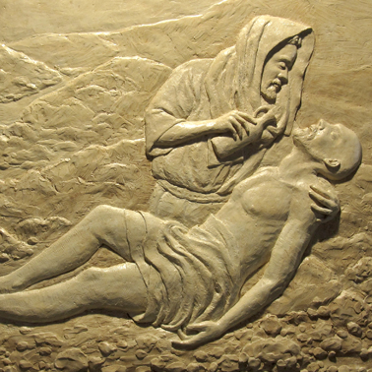
Love displayed to…
those who are hurting
Reaching out with Christ’s love to those in need around us…

