Slide 2
“Some of the elders of Israel came to me and sat down in front of me. Then the word of the LORD came to me: “Son of man, these men have set up idols in their hearts and put wicked stumbling blocks before their faces. Should I let them inquire of me at all? Therefore speak to them and tell them, ‘This is what the Sovereign LORD says: When any of the Israelites set up idols in their hearts and put a wicked stumbling block before their faces and then go to a prophet, I the LORD will answer them myself in keeping with their great idolatry. I will do this to recapture the hearts of the people of Israel, who have all deserted me for their idols. ““Therefore say to the people of Israel, ‘This is what the Sovereign Lord says: Repent! Turn from your idols and renounce all your detestable practices!” Ezekiel 14:1-6

Slide 3
1)What is our heart?
2) What we do with
our hearts
3) What God does with
our hearts

Slide 4
1)What is our heart?

Slide 5
Our affection, that which we LOVE the most, will evoke the fiercest of our emotions.

Slide 6
REASON
Logic, thinking, analysis, study
EMOTIONS
How we feel
AFFECTIONS
What we love

Slide 7
Our affection, that which we LOVE the most, will evoke the fiercest of our emotions.

Slide 8
Our affection, that which we LOVE the most will engage, influence and even twist our reasoning.

Slide 9
OUR AFFECTIONS > EMOTIONS AND REASON

Slide 10
The heart thinks
“The Lord saw how great the wickedness of the human race had become on the earth, and that every inclination of the thoughts of the human heart was only evil all the time.”
Genesis 6:5 NIV

Slide 11
sometimes we think with our minds
sometimes we think with our hearts

Slide 12
The heart plans
“To humans belong the plans of the heart, but from the Lord comes the proper answer of the tongue.”
Proverbs 16:1 NIV

Slide 13
The heart feels
“The Lord regretted that he had made human beings on the earth, and his heart was deeply troubled.”
Genesis 6:6 NIV

Slide 14
According to the Bible, the heart thinks, feels and plans.
the heart is the seat of all our reason, emotion and affection.

Slide 15
1
My heart not only sets the direction for my life (by thinking, feeling and planning), it also gives me the motivation to travel in that direction.

Slide 16
II
We sin with our hearts.
We worship God with our hearts.

Slide 17
2) What we do with our hearts

Slide 18
Generally, the human heart cannot
remain affection-less for too long

Slide 19
We all have many affections,
but our hearts long
for one supreme affection...

Slide 20
Our emotions reveal the
affections of our hearts

Slide 21
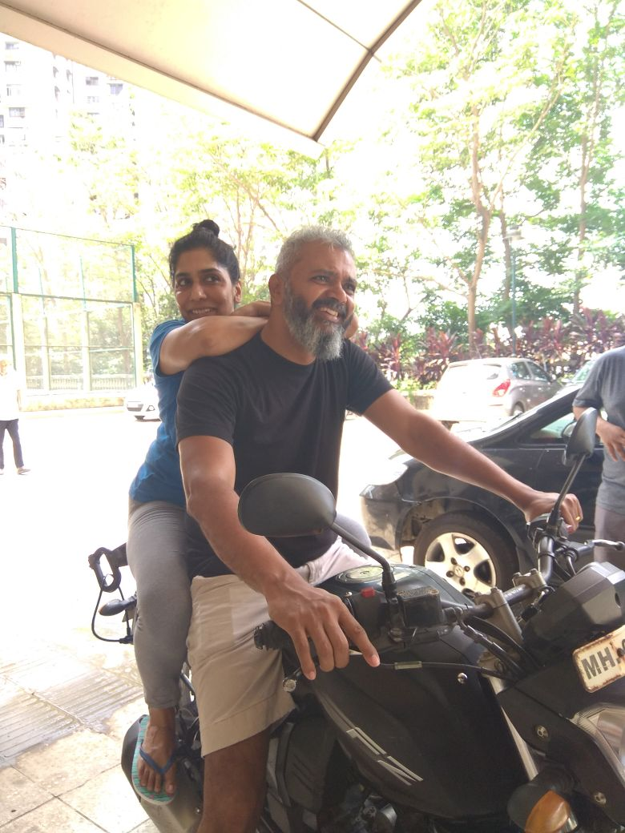

Slide 22
The human heart will immediately
seek an alternate affection
when an existing
affection disappoints us;
it doesn't naturally turn to God

Slide 23
“Some of the elders of Israel came to me and sat down in front of me. Then the word of the LORD came to me: “Son of man, these men have set up idols in their hearts and put wicked stumbling blocks before their faces. Should I let them inquire of me at all?
Ezekiel 14:1-6

Slide 24
All affections, except our affection
for God, will ultimately fail us

Slide 25
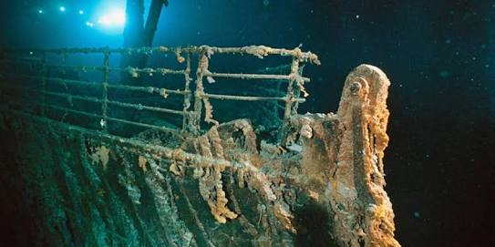

Slide 26
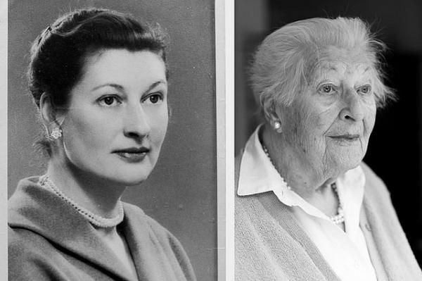

Slide 27
3) What God does with
our hearts

Slide 28
I will do this to recapture the hearts of the people of Israel, who have all deserted me for their idols. ““Therefore say to the people of Israel, ‘This is what the Sovereign Lord says: Repent! Turn from your idols and renounce all your detestable practices!”
Ezekiel 14:1-6

Slide 29
When we give our hearts away,
we give our selves away...

Slide 30
‘When any of the Israelites or any foreigner residing in Israel separate themselves from me and set up idols in their hearts and put a wicked stumbling block before their faces and then go to a prophet to inquire of me, I the Lord will answer them myself.”
Ezekiel 14:7 NIV

Slide 31
What Jesus endured on the cross
was not mere
suffering; more importantly, it was
punishment

Slide 32
Growing in our love for Jesus
is not an individual pursuit.
We need church community to do this well.

Slide 33
Christ Jesus instituted the
communion to recapture our hearts

